Slide 1
Alcohol consumption data
Data collected from students at 2 Portuguese secondary schools
Alcohol consumption was reported in terms of a 1 (very low) to 5 (very high) rating on weekdays and weekends
Illegal consumption of alcohol is not necessarily a concern because as of 2014, Portugal laws allowed anyone 16 or older to purchase alcohol [1]
Additional data was acquired via a survey of University of Utah students
Duplicates were present in the data, so a merge was performed
1. http://www.who.int/substance_abuse/publications/global_alcohol_report/profiles/prt.pdf
Notes:
We used data gathered from 2 Portuguese secondary schools. Alcohol consumption was rated from 1-very low to 5-very high. We also gathered data from University of Utah students through a survey. Our major data cleaning challenge involved merging data for students who were surveyed twice.

Slide 2
Data Cleanup
Since data was gathered in both math classes and Portuguese classes, some students were surveyed twice
Data was reported in two sets, one for math classes and another for Portuguese classes
To remove duplicates from the data, a merge was performed between the two sets
All variables except those related directly to the class (grades, attendance) type were used as a basis of comparison for the merge
Class-dependent variables were combined into single values for each student by averaging
Categorical variables were converted to integer values

Slide 3
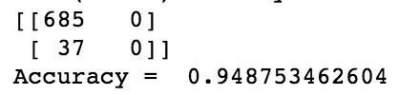
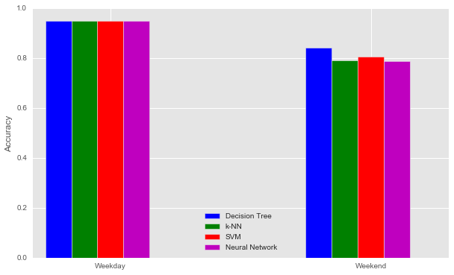
Exploring Classification
SVM
C = 2.2 weekend
C < 3.4 weekday
Rbf kernel
Decision Trees
Max depth = 5, min split = 100 weekend
Max depth = 4, min split = 100 weekday
K-Nearest Neighbors
20 ≥ k ≥ 30 weekend
k ≥ 10 weekday
Weighted by distance
Weekday Model Confusion Matrix
Neural Networks
125 nodes
Notes:
In order to classify this data, we grouped the alcohol consumption ratings into a “low” group with ratings 1-3 and a “high” group with ratings 4-5.
To test accuracy of models, the cross_val_predict function was used, splitting the dataset into 2 for training and testing.
Tried to classify weekday and weekend alcohol consumption separately using all the variables in the dataset
Considered SVM, Decision Trees, and k-Nearest Neighbors
These are the parameters that resulted in the highest accuracies
If the independent variables were limited, accuracies went down.
We also tried using neural networks
[and found 125 nodes consistently produced the best results, despite random initialization]
[However, behavior was similar to SVM, and even did a little worse on weekend alcohol consumption]
Had higher accuracies for weekday models – however highest accuracies for those models arise from assuming low alcohol consumption regardless of input variables since the majority of the training data had low ratings (94.9%), seen in the confusion matrix here
Weekend models did a better job at trying to predict high alcohol consumption, even though they had lower accuracies : Decision Trees ended up with the highest accuracy of 84.2%
[Decision Tree Primary splits: Father’s job]
[If a rating of 3 was considered high instead of low, accuracies also went down, but the models did better at trying to predict high alcohol consumption. However, we stuck with keeping 3 in the low category due to wording in the survey.]

Slide 4
Multilinear Regression
Independent variables:
Weekday alcohol consumption
Frequency of outings
Gender
Frequency of time spent on studying
Dependent variable:
Weekend alcohol consumption
R² = 0.484
Notes:
Also tried using regression to potentially be able to predict an alcohol consumption rating 1 – 5 from inputs
Best results came from using these variables
[, which had the highest correlation with weekday and weekend alcohol consumption ratings
though the highest was between the weekday and weekend ratings themselves with only 62%]
This model only explains 48% of the variance in weekend alcohol consumption rating with the independent variables considered
And it’s not necessarily a useful model as it requires knowing the weekday rating to guess the weekend rating
[However, if we remove the weekday rating from the independent variables, the R-squared goes down to 27%]

Slide 5
Clustering
Three different clustering algorithms were implemented
k-Means
Hierarchical
DBSCAN
Purpose
If clusters are present, we can see what the clusters consist of to give us new insights
Example: Maybe there’s a cluster of students with divorced parents?

Slide 6
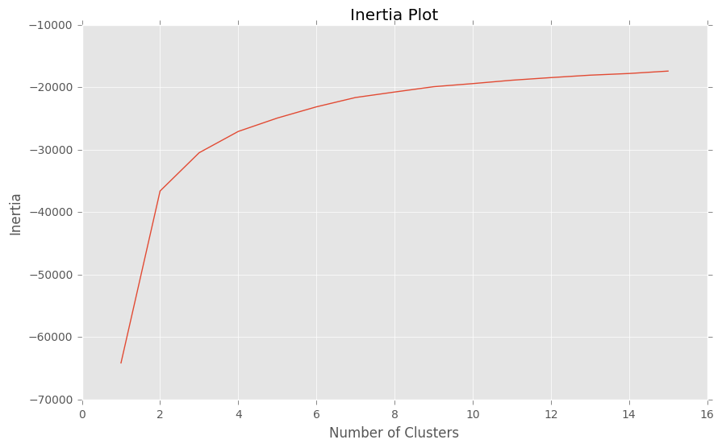
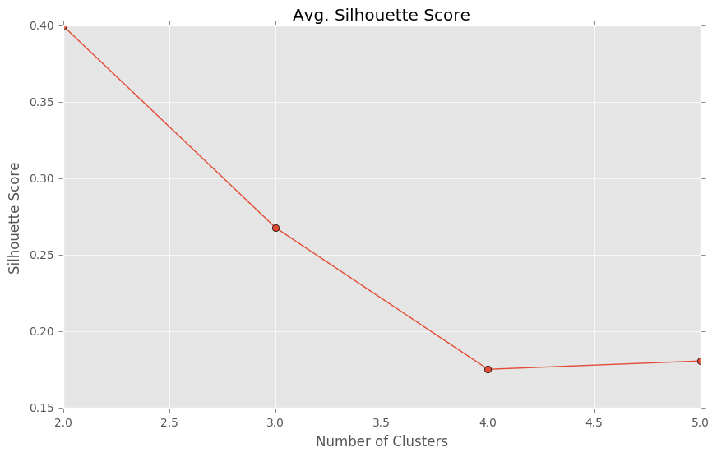
k-Means
Tried one through fifteen clusters
Decided to focus on two through five clusters
Silhouette Score (measure of distance from other clusters) wasn’t promising
+1 is best, -1 is worst

Slide 7
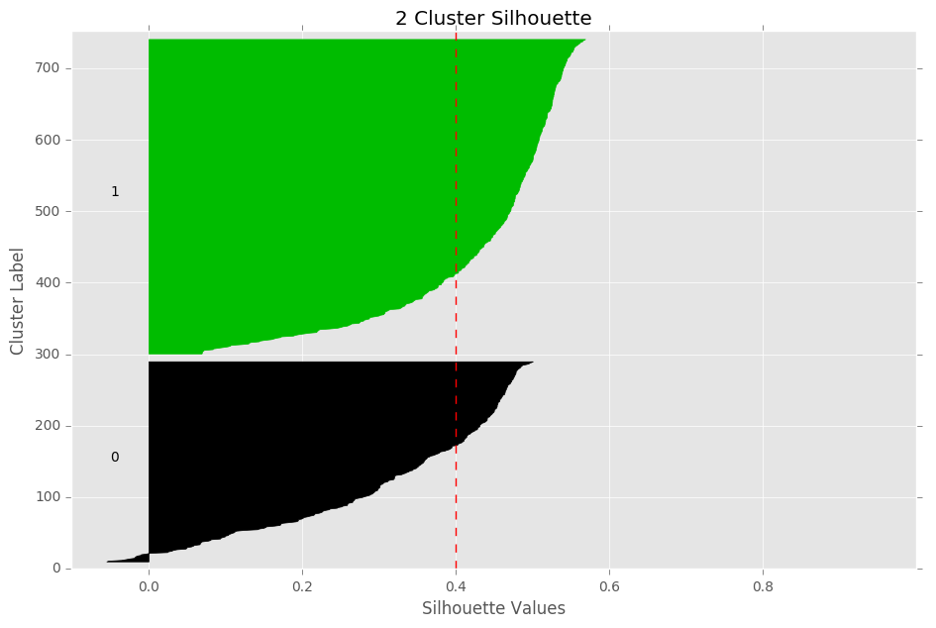
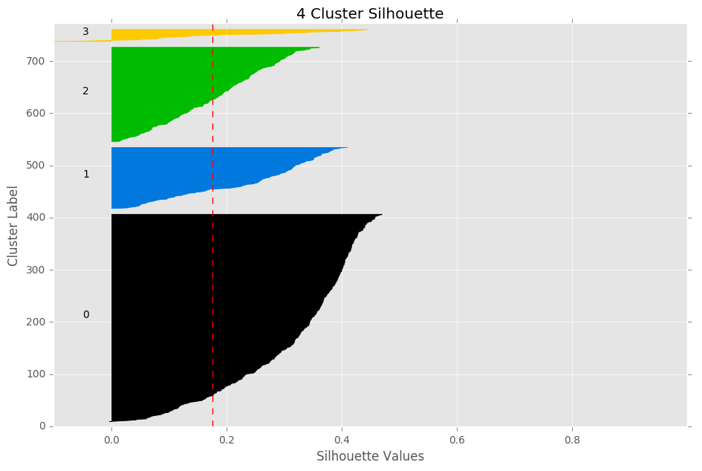
k-Means Silhouette Plots
Silhouettes aren’t close to +1, shape isn’t boxy

Slide 8
What about Hierarchical?

Slide 9
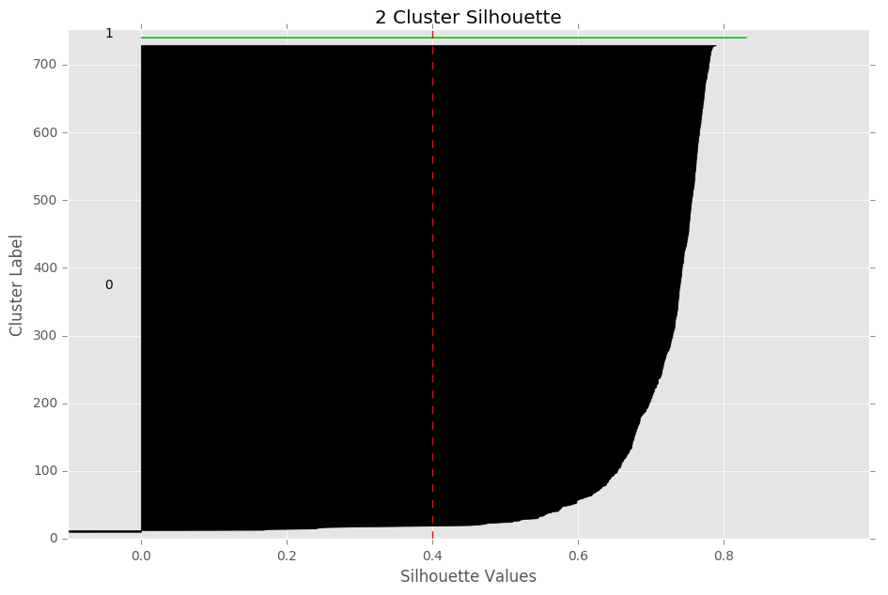
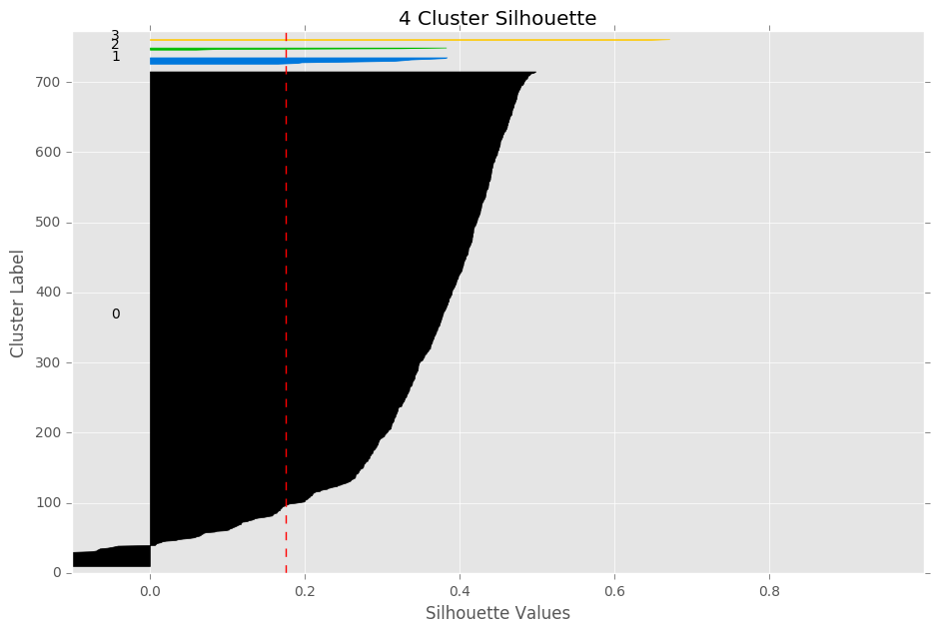
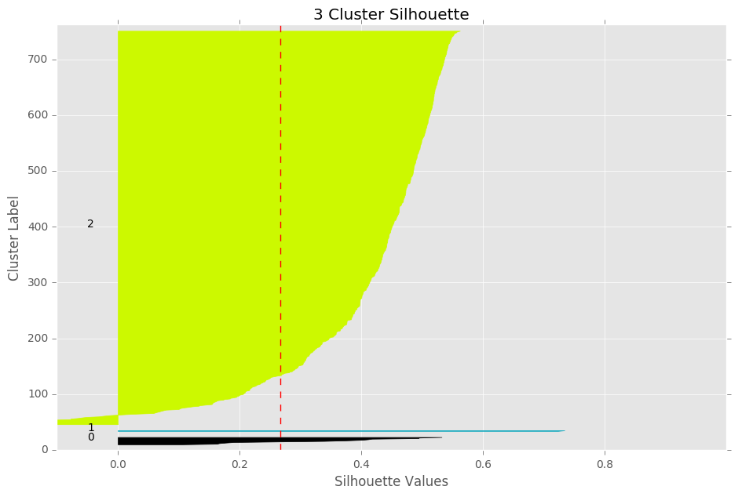
Hierarchical Silhouette Plots

Slide 10
DBSCAN
Tried one last algorithm, DBSCAN
DBSCAN determines the number of clusters for you
DBSCAN classified all points as noise
This may imply that there are no real clusters, or one large cluster

Slide 11
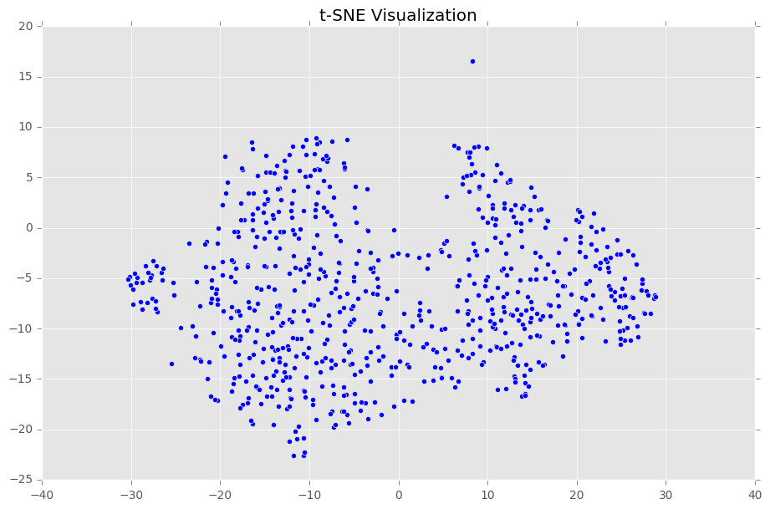
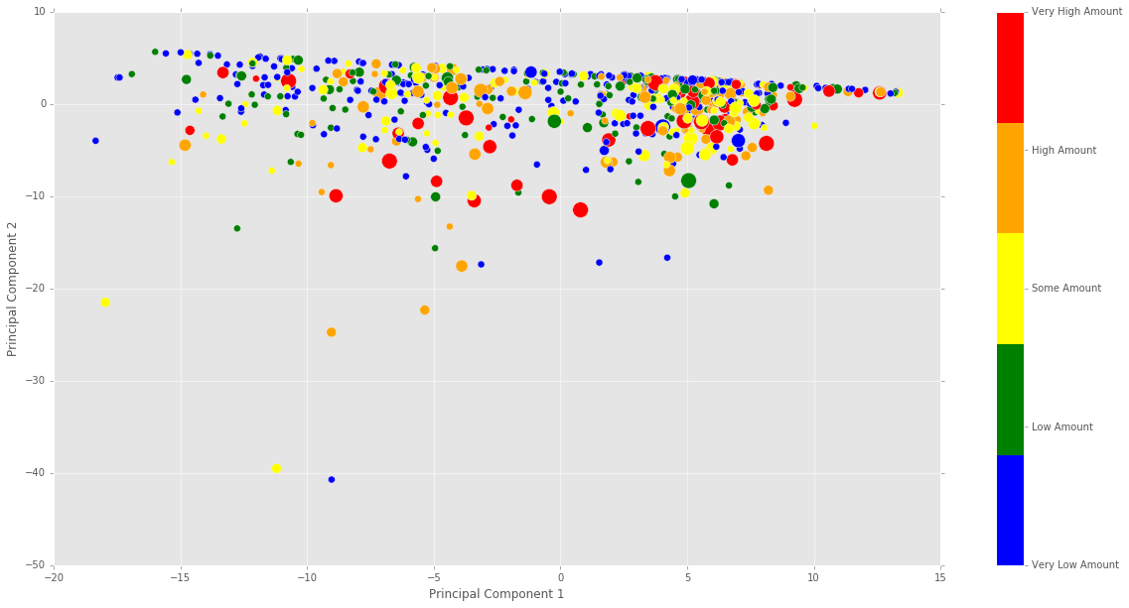
Dimensionality Reduction - Visualization
t-SNE
PCA

Slide 12
Survey

Slide 13
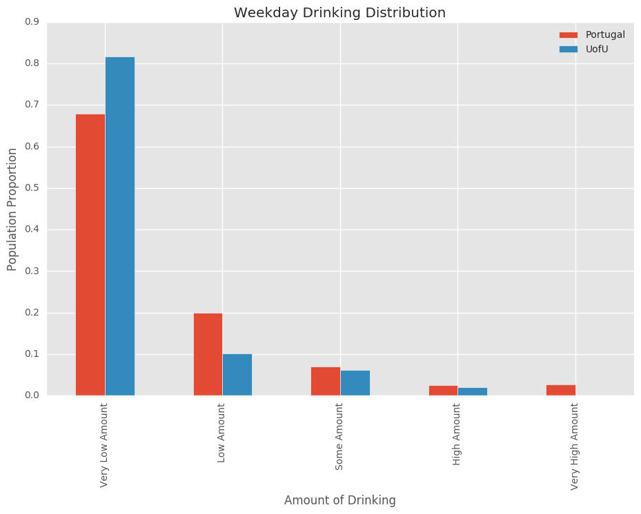
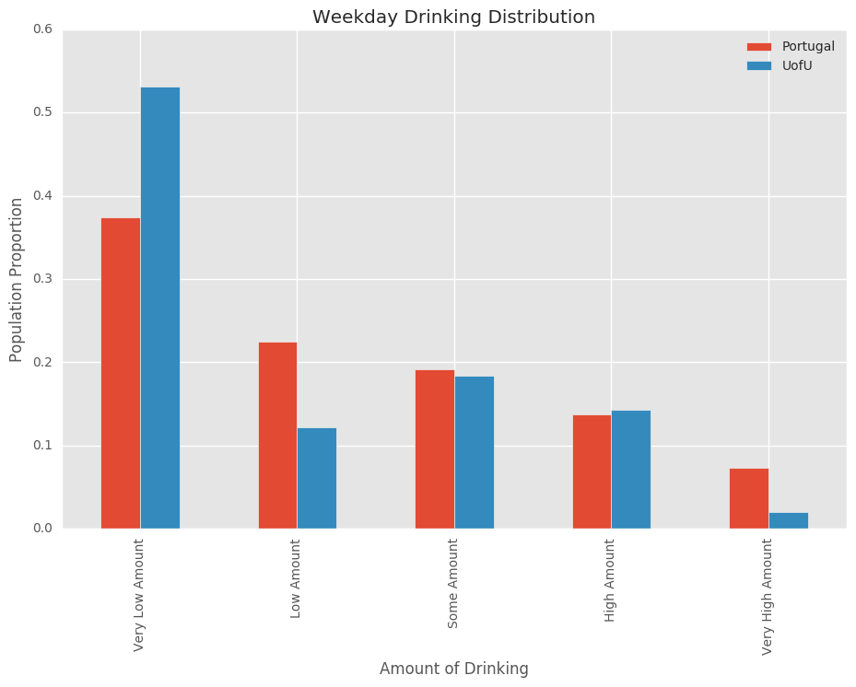
Alcohol Consumption

Slide 14
Conclusion
Clustering and dimensionality reduction visualization showed the dataset is really one big cluster
The best model for predicting high vs. low alcohol consumption came from a decision tree model on weekends
max depth 5
min split 100
84.2% accuracy
This dataset was not good enough for predicting alcohol consumption
Not large enough
Doesn’t contain the best features
Subjective and incomplete data

